Slide 1
Sentiment Analysis of Ebay Reviews
Portflio Project
BY:-
Rishabh P Pattewar
DF2009CM

Slide 2
Objective
An text analyzer that collects reviews from the users about a certain product and analyzes them. It would segregate the reviews into positive and negative reviews. The negative reviews will be helpful to the companies to further enhance their product based on the user's’ feedback .It is based on the ratings.

Slide 3
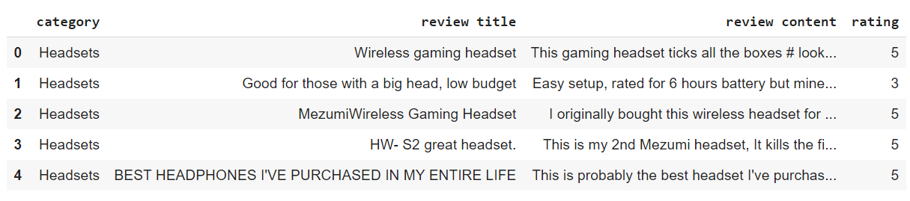
Data
Sentiment analysis of Ebay reviews
Dataset Link: Ebay reviews | Kaggle
Size of dataset: Rows: 44756 Columns: 4.
Applied Random under Sampling

Slide 4
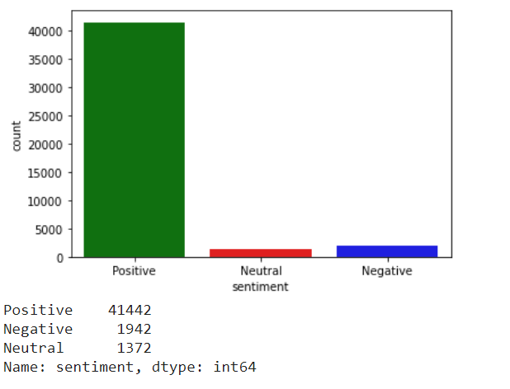

Slide 5
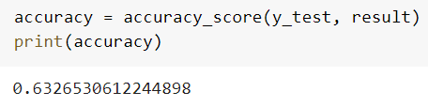
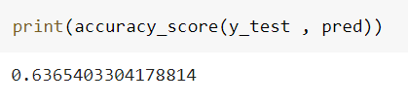
Models
Logistic Regression
Multinominal Naive Bayes

Slide 6
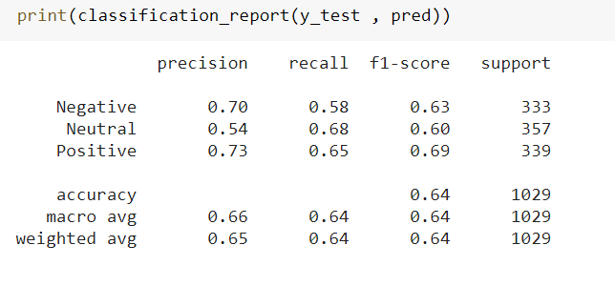
Report

Slide 7
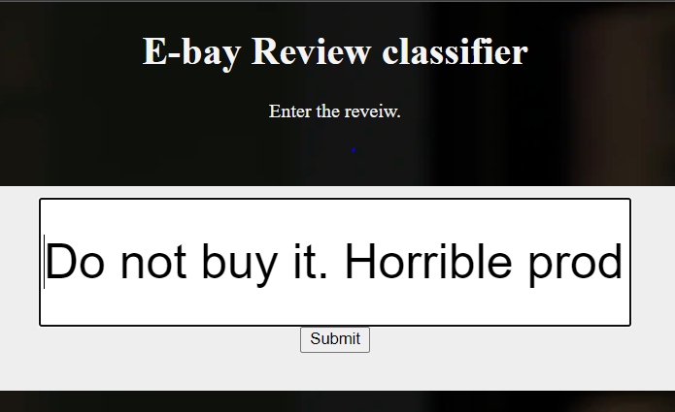
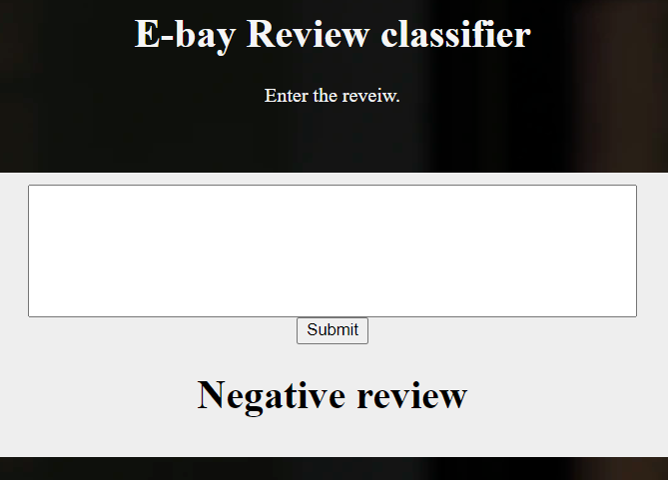
Result
Input
Output
Thank You!!!

